Slide 1
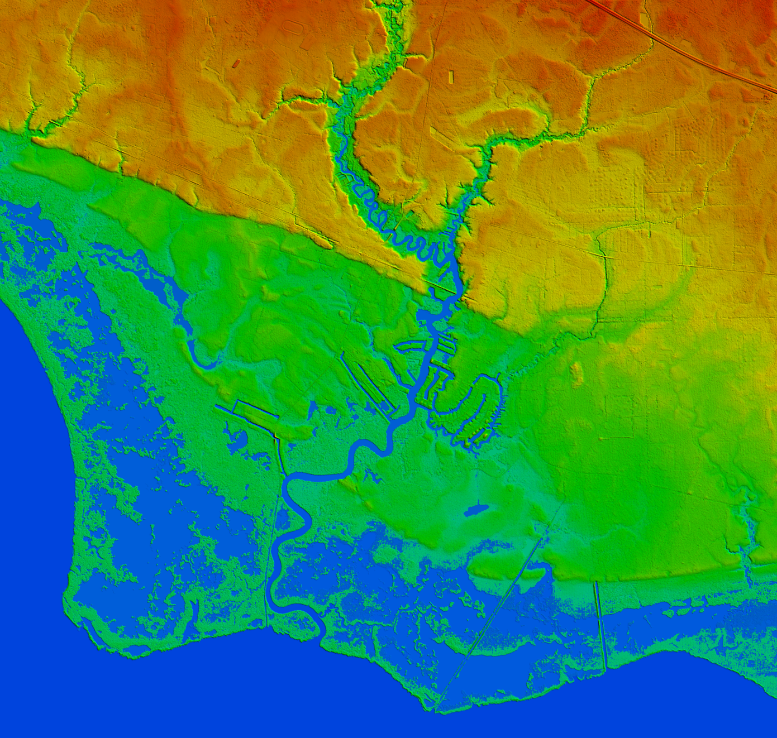
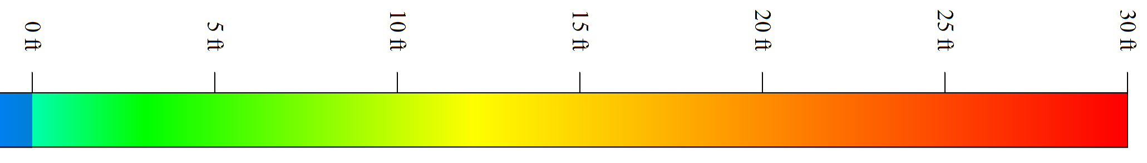

Legal Aspects of Coastal Change
State of the Coast 2016
New Orleans
Edition 31
as of June 1, 2016
P.O. Box 40873
Baton Rouge, LA 70835
riparian@bellsouth.net
Wetland Consultants
Notes:
Spoken but not printed at GSA -
“Science” is about “What’s a fact?”*
“Law” is about “Which facts matter?”
*Allowing for the late Roy Dokka’s caveat that the ideas of both “fact” and “true” are really just verbal shorthand for:
Currently confirmed by all experiments so far and consistent with the prevailing hypo/model of the world while being constantly subject to wholesale revision as soon as a new experimental result points elsewhere and/or somebody comes up with a new hypo/model fitting all the current data points but better explaining why the trial/test worked out as it did.

Slide 2
Not “What to think . . .”
but rather
. . . what to think
about.

Slide 3
Science
“What’s a fact?”
Law
“Which facts matter?”
Economics
“What do people want most?”
Politics
“What do most people want?

Slide 4

“There will never be enough Right Stuff to overcome the laws of physics.”
(Armstrong Labs/NASA Ames, night vision goggles talk 1992)

Slide 5
The view from 10,000 feet
a/k/a “Higher up the Ladder of Abstraction”
Law “theory of the case”
Wetland Delineation “map in your head”
Flying “situational awareness”
Science “the theory of ________”
sometimes “the model of ______”

Slide 6
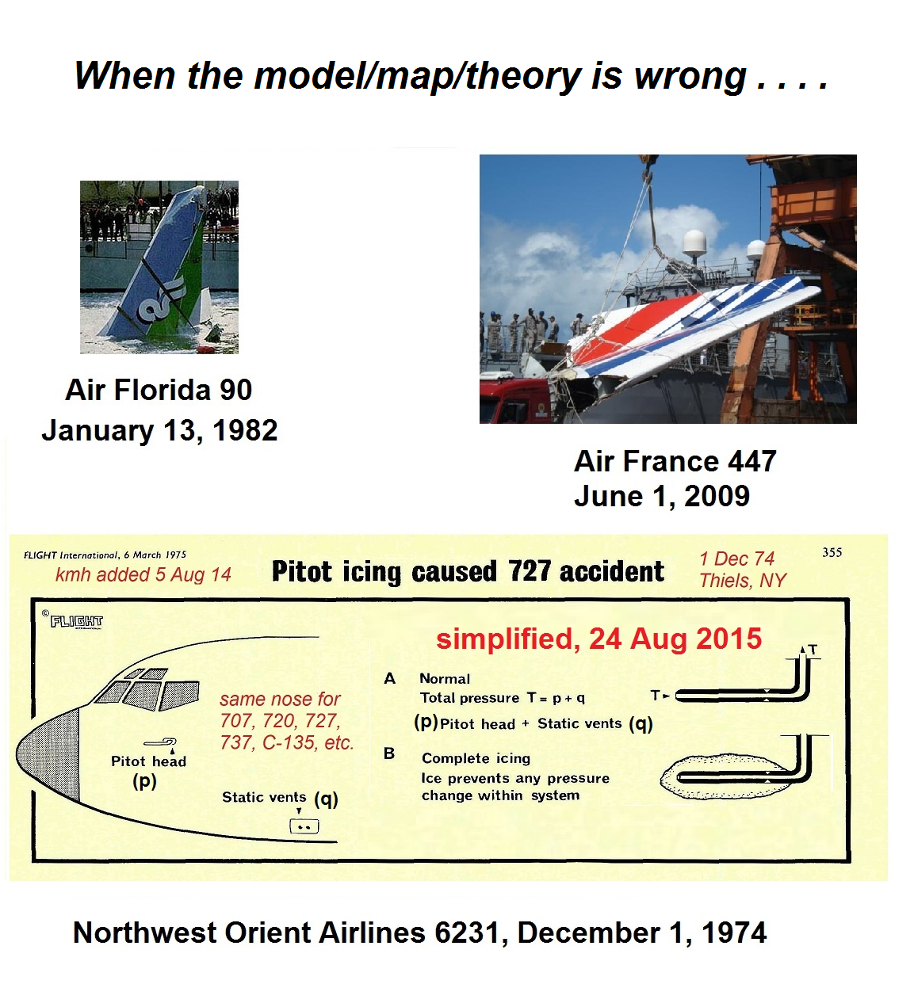

Slide 7
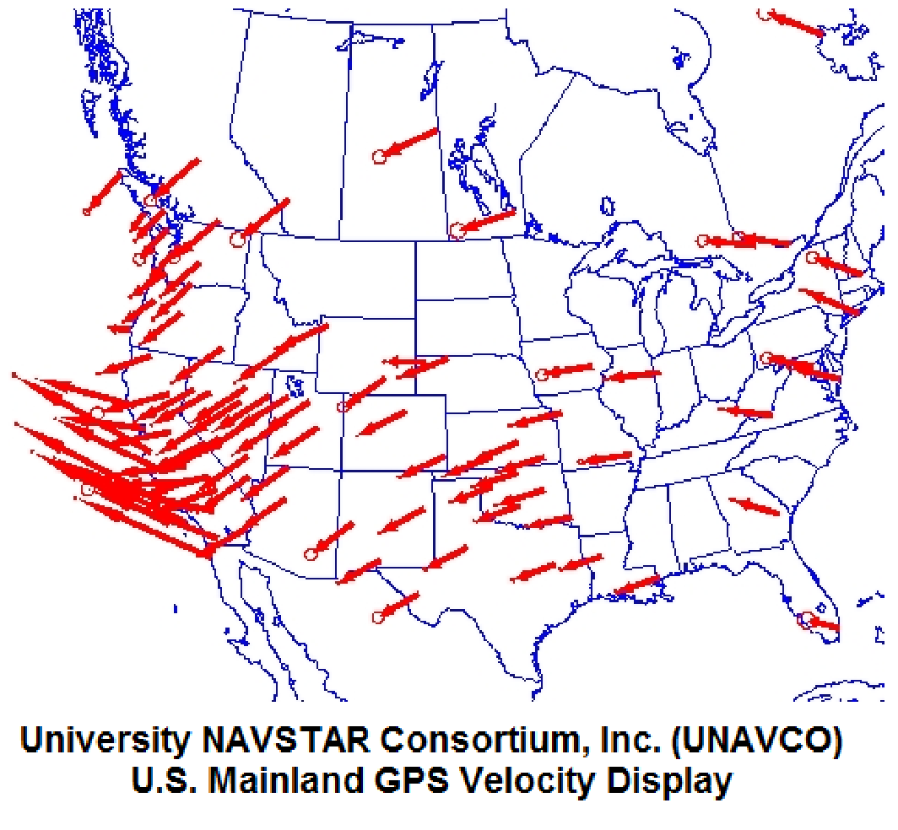

Slide 8
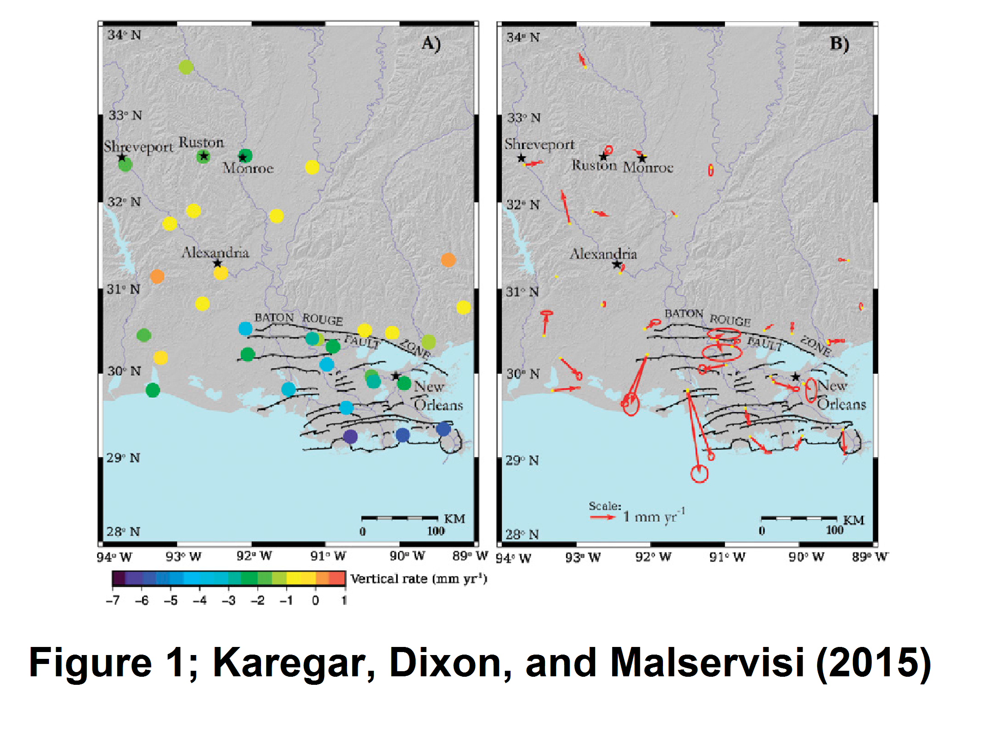

Slide 9
Where’s the beach?
Who owns it?
Who wins in court, and why?
Where to from here?

Slide 10
skip over
Where’s the beach?
Yes, Virginia, there IS a “public trust doctrine.”
BUT, we’re not going to cover
very much of it because that
would easily take all day!

Slide 11
skip ahead/skip over
Who wins in court, and why?
Diversions affecting oyster beds
Avenal et al v. Louisiana, 886 So.2d 1085 (La. 10/19/04)
Land loss from E & P (exploration and production) canals
Barasich v. Columbia Gulf Trans. Co., 467 F. Supp. 2d 676 (E.D. La. 2006)
AGW/Climate Change made storms and coastal damage worse
Native Village of Kivalina v. Exxon Mobil Corp., 696 F.3d 849 (9th Cir.
2012); cert denied 2013, and Comer v. Murphy Oil USA, 43 ELR 20109
(5th Cir., 05/14/2013)
Increased levee costs from E & P canals and production itself
Bd of Comm’ of the S.E. La. Flood Protection Authority-East v. Tenn. Gas
Pipeline Co., LLC., et al., file No. 13-6911 (D. Ct. Orleans Parish, La.
Jul 24, 2013); removed then dismissed (E.D. La. 2015)

Slide 12
Corpus Iurus Civilis (Body of Civil Law), Institutes, Book II, Of
Things; [Chapter] I. Divisions of Things; [Article] 3. Issued in
three parts between 529 (AD) and 533 at the order of Emperor
Justinian, but copied from 1st Century Roman law.
Where’s the beach?
The seashore extends as far as
the greatest winter flood runs up.

Slide 13
Where’s the beach?
Seashore is the space of land over
which the waters of the sea spread
in the highest tide during the winter
season.
La. Civil Code Article 451, “Seashore” (last reenacted by Acts 1978, No. 728, §1)
La. Supreme Ct. was asked to interpret Art 451 to mean the land “normally covered
by the highest tide of the year” but declined because the legislature writes statutes,
not the courts.
See Roy v. Bd of Comm of Pontchartrain Levee Dist, 117 So. 2d 60 (1960).

Slide 14
Where’s the beach?
The seashore extends as far as
the greatest winter flood runs up.
Justinian copying Roman law
Seashore is the space of land over
which the waters of the sea spread
in the highest tide during the winter
season.
La Civil Code copying Justinian

Slide 15
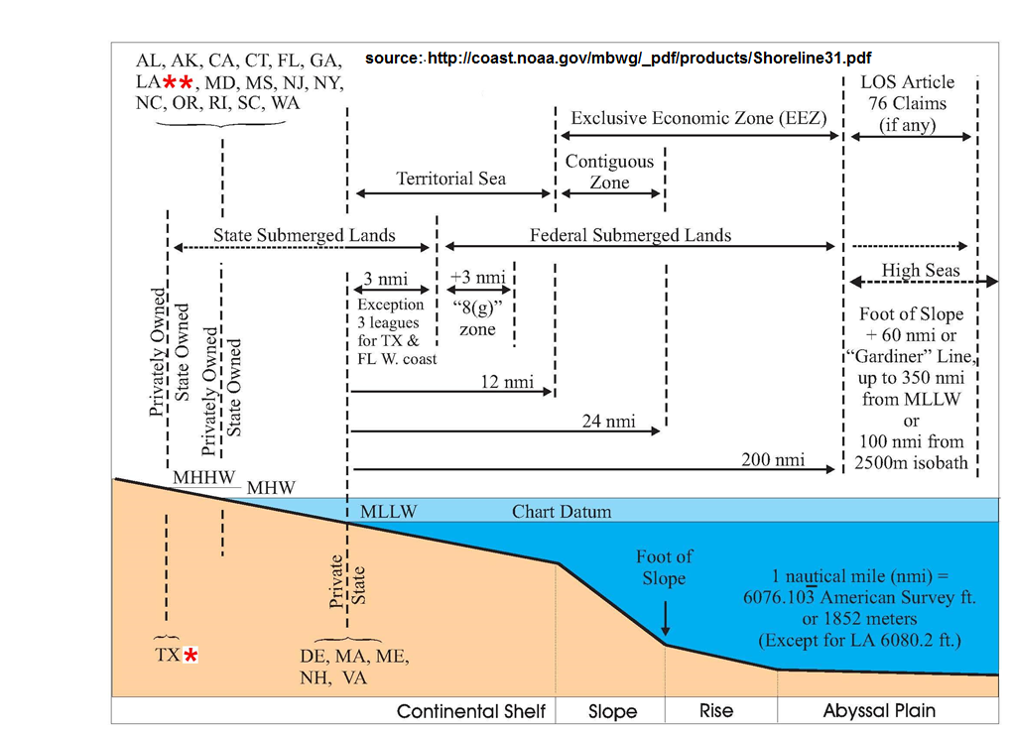
Where’s the beach? (Marine Boundary Working Group)

Slide 16
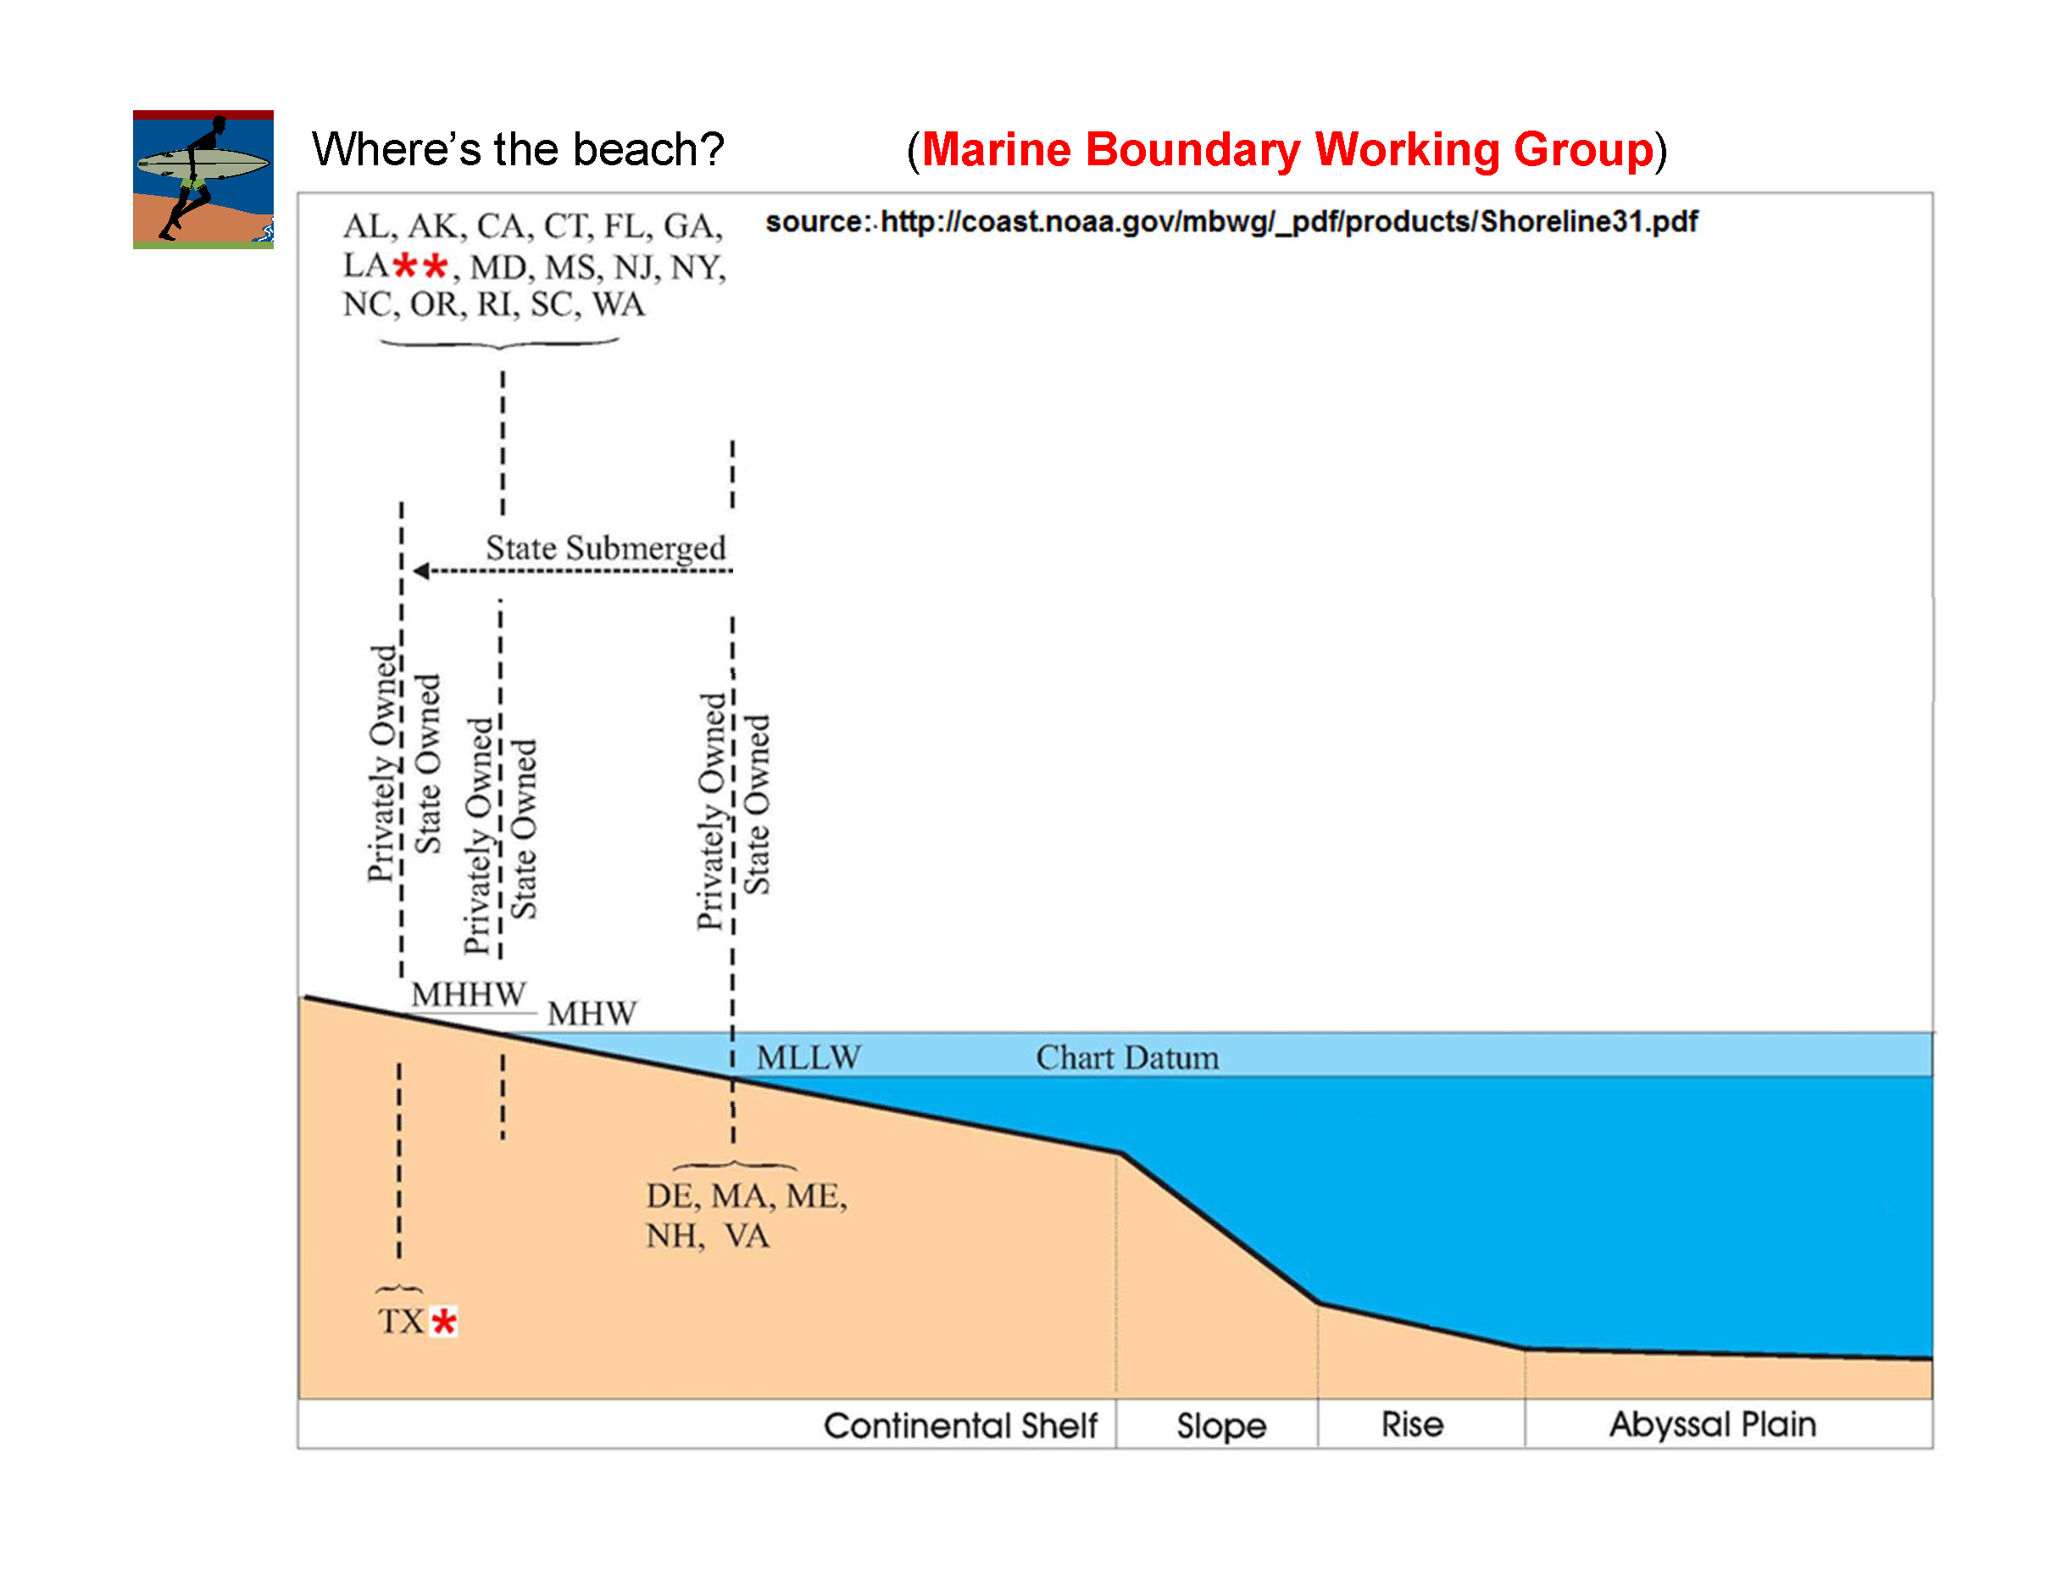
U.S. v. California, 332 U.S. 19 (1947)
U.S. v. Louisiana, 339 U.S. 699 (1950)
U.S. v. Texas, 339 U.S. 707 (1950)
States cannot claim any submerged
lands offshore.
Submerged Lands Act of 1953
U.S. v. La, Tex, Miss, Ala, and Fla, 363 U.S. 1 (1960)
La not entitled to an extended
boundary

Slide 17
Where’s the beach?
Old Louisiana Law, from 1978 (still the law today):
R.S. 41 §1702. Reclamation of lands lost through erosion, compaction,
subsidence, and sea level rise . . . .
D.(2)(e) However, no land which lies below the elevation of ordinary
low water shall be considered emergent land.
New Louisiana Law (2011)
R.S. 49:3.1, §1. Gulfward boundary (not yet in effect; unlikely ever will)
B. The coastline of Louisiana shall be the line of ordinary low water along that portion of the coast which is in direct contact with the open sea and the line marking the seaward limit of inland waters, and shall be not less than the baseline defined by the coordinates set forth in U.S. v. La, 422 U.S. 13 (1975), Exhibit "A". Under no circumstances shall the coast-line of Louisiana be nearer inland than the baseline established by such coordinates. [emphasis added]

Slide 18
Where’s the beach?
Moreover, the alluvial soil added by a river to your land
becomes yours by the law of nations. Alluvion is an
imperceptible increase; and that is added so gradually
that no one can perceive how much is added at any one
moment of time.
Institutes, Book II, Of Things; [Chapter] I. Divisions of Things; [Article] 20.
http://www.fordham.edu/halsall/basis/535institutes.html#I. Divisions of Things
If the accretion originates from a river bank, the riparian
(private) owner gets that land - - but if it originates from the
beach, then Louisiana owns it. Remand (“do over”) to figure
out which one (or parts of both?) happened.
See Davis Oil Co. v Citrus Land Co. 576 So.2d 495 (La. 1991)

Slide 19
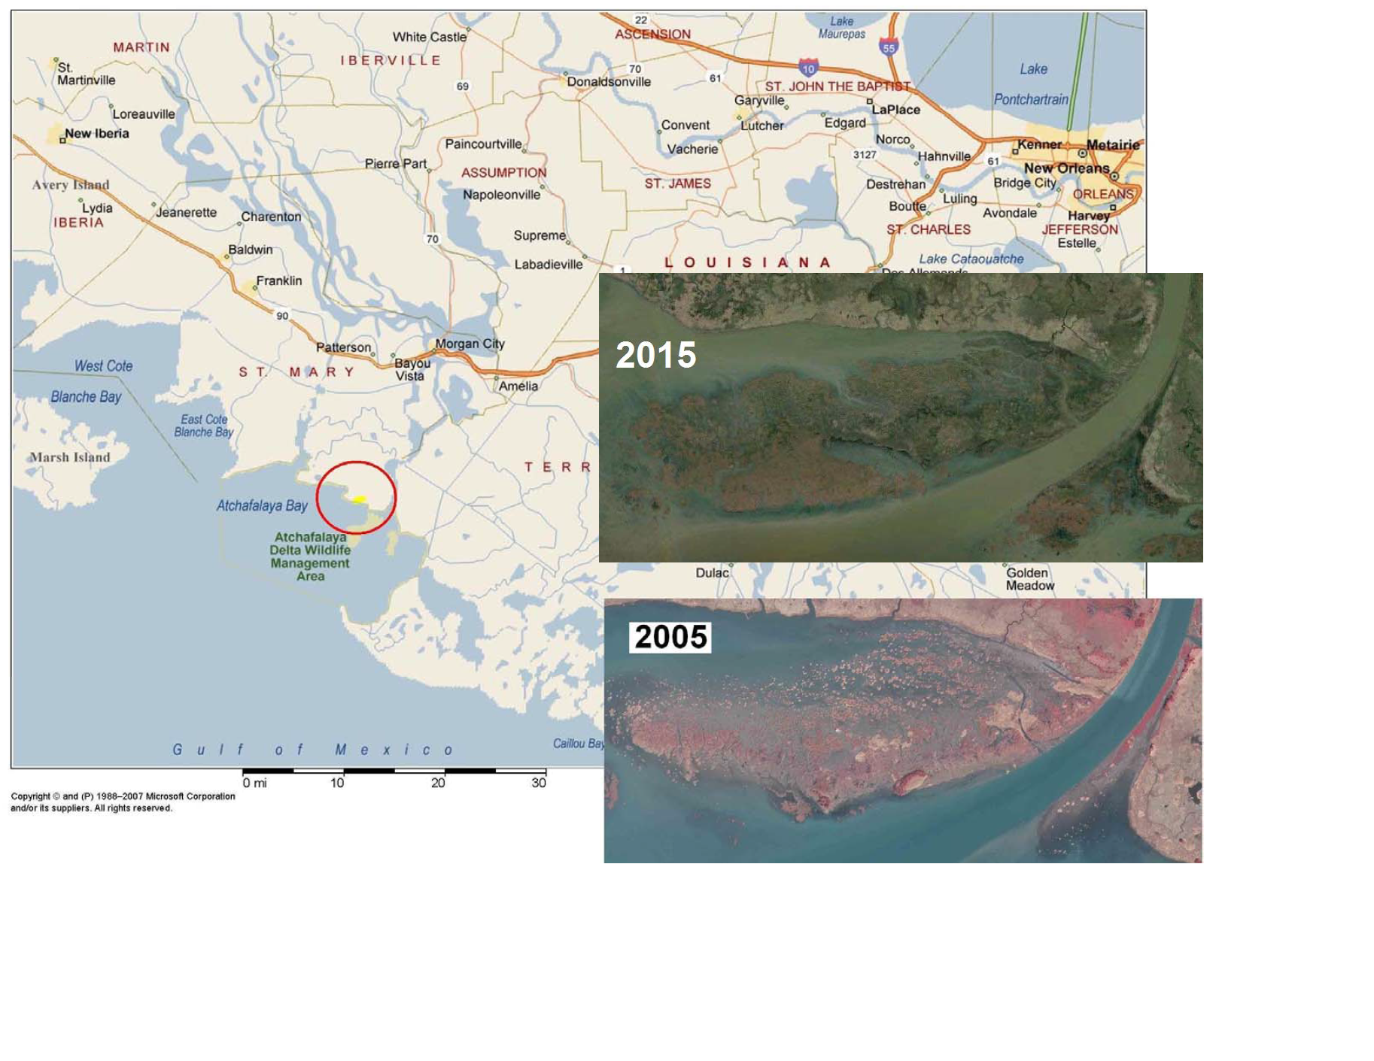
Davis Oil Co. v Citrus Land Co. 576 So.2d 495 (La. 1991)

Slide 20
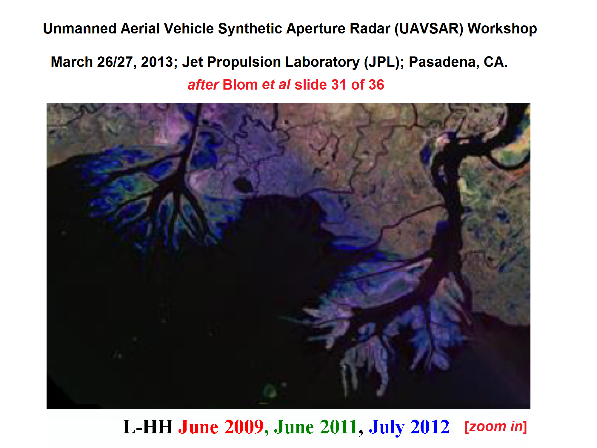

Slide 21
Who owns it? Pollard v. Hagan (1845)
. . . these general conclusions:
First, the shores of navigable waters, and the soils under them, were not granted by the Constitution to the United States, but were reserved to the States respectively.
Secondly, the new States have the same rights, sovereignty, and jurisdiction over this subject as the original States.
“equal footing” doctrine at (page 230) in Pollard’s Lessee v. Hagan, 44 U. S. 212 (1845); comes from Northwest Ordinance (1787; Articles of Confederation)

Slide 22
Phillips v. Miss (1988)
Who owns it?
“ . . . by virtue of becoming a State, Mississippi acquired ‘fee simple title to all lands naturally subject to tidal influence, inland to today’s mean high water mark’ . . . .” [emphasis added]
Phillips Petroleum Co. v. Mississippi, 484 U.S. 469 (1988)
Expands Pollard to tidally influenced; not limited only to
navigable waters

Slide 23
Who owns it?
Phillips resulted in a massive study of Louisiana law going back to French/Spanish times
LSU Law Review published (1992) opposing articles on what to do
Legislature adopted the view most favorable to private ownership
Law student just published an LSU Law Review article calling for change
If interested, see:
Jacques Mestayer, Saving Sportsman’s Paradise: Article 450 and
Declaring Ownership of Submerged Lands in Louisiana, 76 La. L. Rev.
(2016)
Available at: http://digitalcommons.law.lsu.edu/lalrev/vol76/iss3/10

Slide 24
Who owns it?
So, whose law controls; state or federales?
These precedents [such as Pollard, Corvallis] are the basis for the equal-footing doctrine, under which a State’s title to these lands was “conferred not by Congress but by the Constitution itself.” It follows that any ensuing questions of navigability for determining state riverbed title are governed by federal law [emphasis added].
Slip opinion page 12 of 30 of PPL Montana, LLC v. Montana, 565 U. S. ___ (2012), No. 10–218; decided February 22, 2012.

Slide 25
Who owns it?
Hughes v. Washington, 389 U.S. 295 (1967)
Beach owned by the U.S. and sold to a private party before Washington became a state.
Ownership of accretion (gradual deposit) is thus controlled by federal law, not state law. Federal common law says new land is owned by the beachfront owner.

Slide 26
Who owns it?
Stop the Beach Renourishment, Inc.
v.
Florida Dept. of Environmental
Protection et al.
560 U.S. 702 (2010)

Slide 27
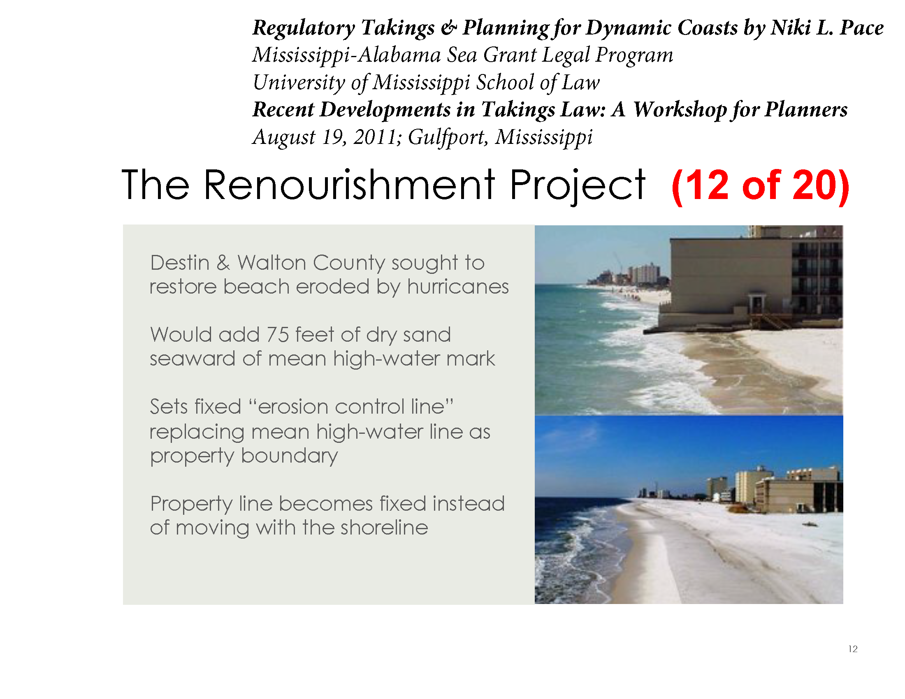
Who owns it?
(note: these file photos are of Orange Beach, AL)

Slide 28
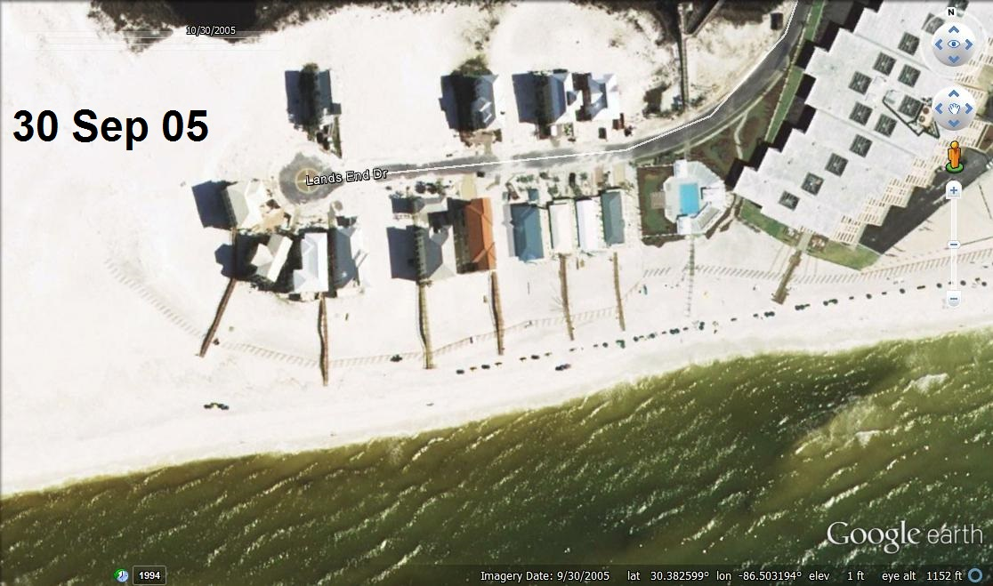
Stop the Beach
Who owns it?

Slide 29
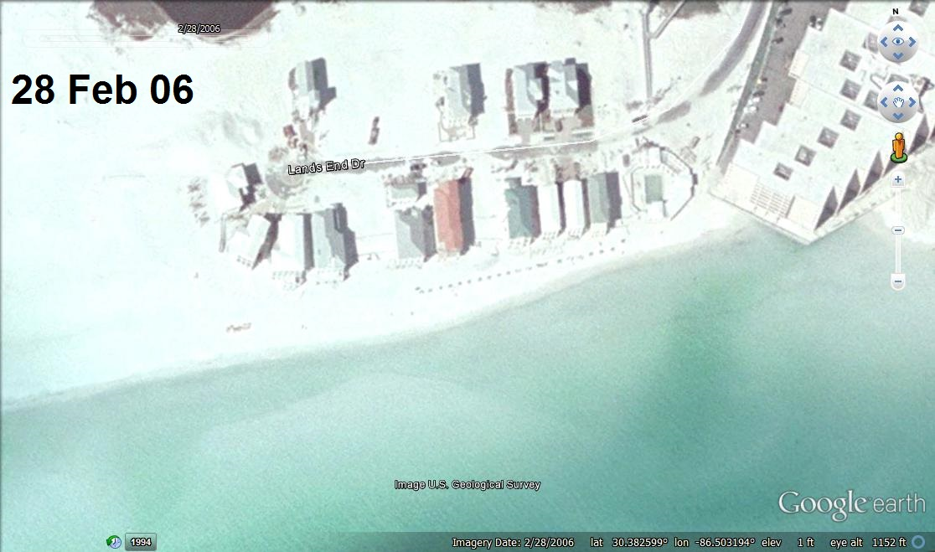
Stop the Beach
Who owns it?

Slide 30
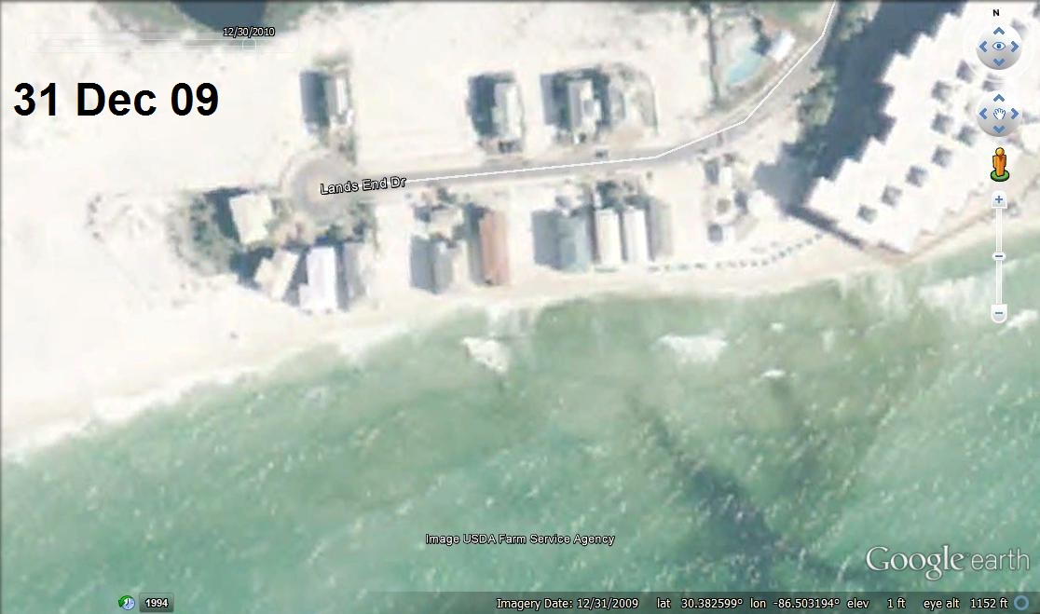
Stop the Beach
Who owns it?

Slide 31
Stop the Beach
Who owns it?
Who wins?
Why?
Right result?

Slide 32
Who owns it?
Stop the Beach
There can be no taking unless petitioner
can show that, before the Florida
Supreme Court’s decision, littoral [beach]
property owners had rights to future
accretions and to contact with the water
superior to the State’s right to fill in its
submerged land.
Notes:
First, the State as owner of the submerged land adjacent to littoral
property has the right to fill that land, so long as it does not interfere
with the rights of the public and of littoral landowners.
Second, if an avulsion exposes land seaward of littoral property that
had previously been submerged, that land belongs to the State even if
it interrupts the littoral owner’s contact with the water. State filling its
own waterbottoms did not deprive beachfront owners of property nor
give them additional land.

Slide 33
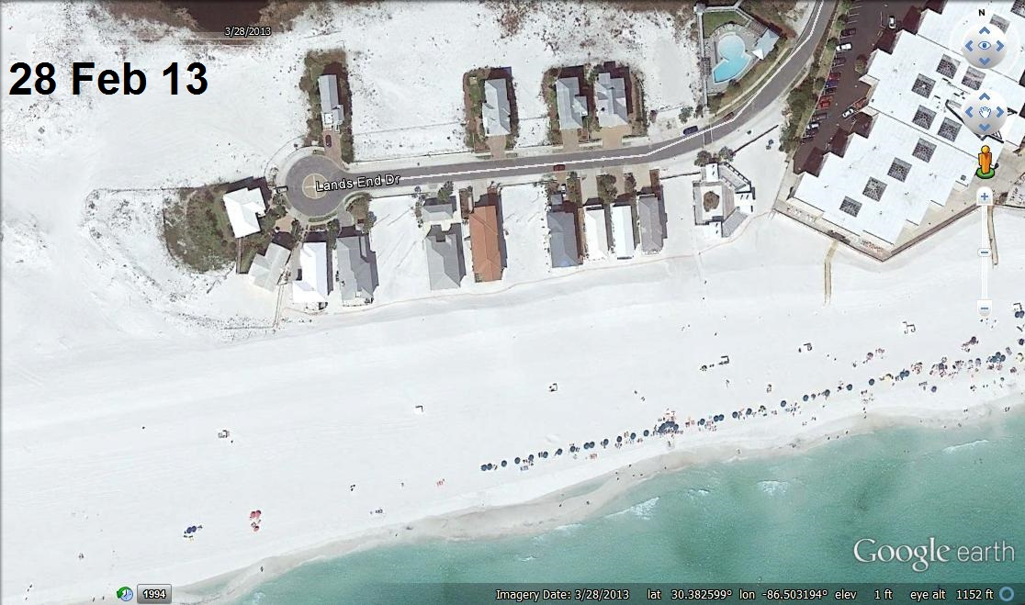
Stop the Beach
Who owns it?

Slide 34
Who owns it?
Hughes v. WA (1967), Citrus v. Davis (1991), and Stop the Beach v. FL (2010) were all about increases in land.
But what about LOSSES?
Does it matter why the land sank?
What if good ol’ Mother Nature did it?
What if nasty ol’ - - hiss; boo - - Big Oil did it?
In other words, does “natural” or “artificial” make any difference?

Slide 35
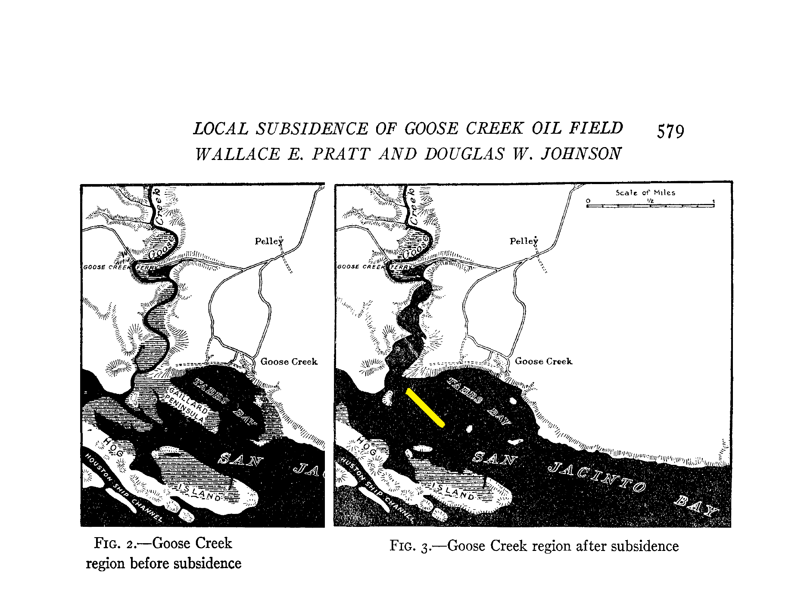
Who owns it?
Texas v. Humble Oil (192x?)
The Journal of Geology, Vol. 34, No. 7,
Part 1 (Oct. - Nov., 1926), pp. 577-590

Slide 36
Who owns it? Texas has had different results:
Coastal Indus. Water Authority v. York, 532 S.W.2d 949 (Tex 1976)
“[S]ubsidence is not ‘an ordinary hazard of riparian ownership; it is not the result
of the force of the waters which takes from some owners and gives to others’.”
(pg 954). Landowner wins; Texas loses.
TH Investments v. Kirby Island Marine, 218 S.W. 3d 173, 184–185 (Tex. App. Houston [14th Dist.] 2007; Tex writ denied 2008: U.S. cert. denied, 129 S. Ct.
899 [2009])
Boundary of public and private ownership along water bodies is not static; as
land becomes submerged, ownership reverts Texas if more than one cause
is making the change.
“(1) York did not involve land covered by tidal waters.” Texas wins
this one.
“(2) York involved only subsidence and not other forces.”

Slide 37
Who owns it? La AG Opinion 07-0137 (Sep 17, 2007)
. . . it is black letter law that as private lands erode [fn 1] into navigable water bodies, that new water bottom be-comes the property of the State. fn2
[1] The term “eroded land” is used in this opinion as a term of art to refer to any property that has submerged below the surface of a navigable water body, be it through erosion, subsidence, or other means. The term “erosion” is also used as a general term of art to refer to a broad swath of mechanisms by which property can become submerged below a navigable water body.
2 La. C.C. Art. 450; A.N. Yiannopoulos, Property, 2 Louisiana Civil Law Treatise § 65, and the authorities cited therein.

Slide 38
Who owns it?
Art. 450. Public things.
Public things that belong to the state are such as running waters, the waters and bottoms of natural navigable water bodies, the territorial sea, and the seashore.
(emphasis added)

Slide 39
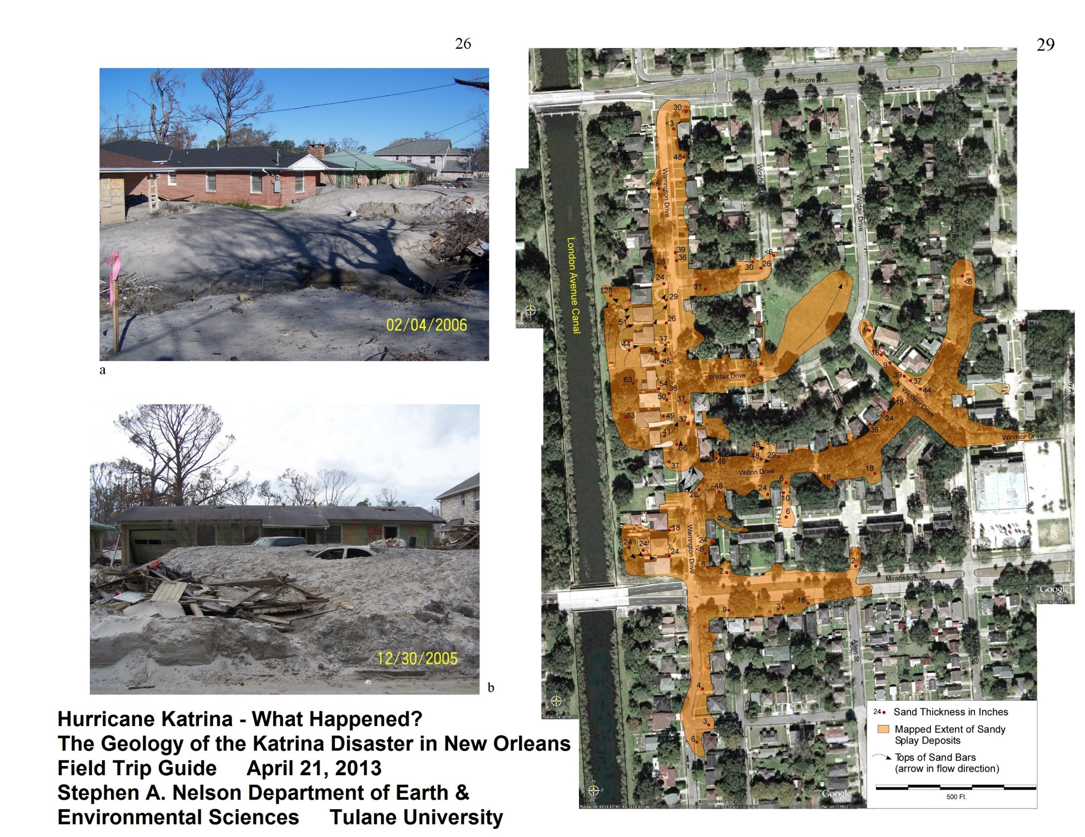

Slide 40
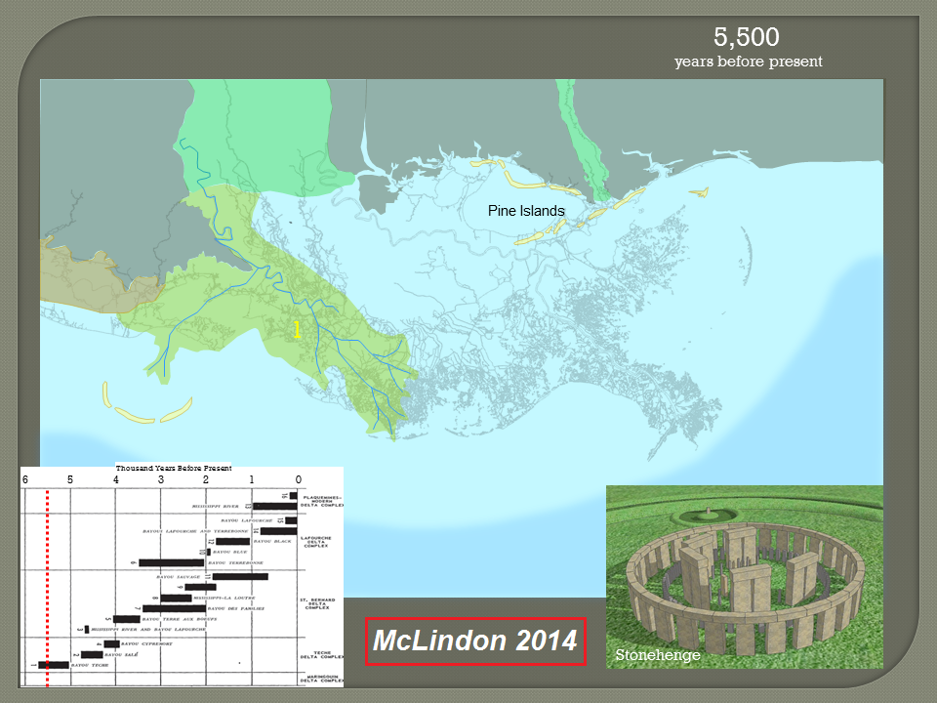
Who owns it?

Slide 41
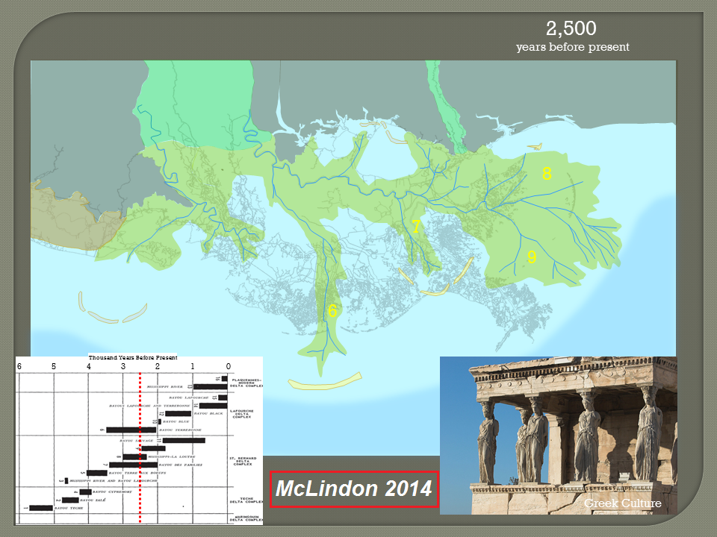
Who owns it?

Slide 42
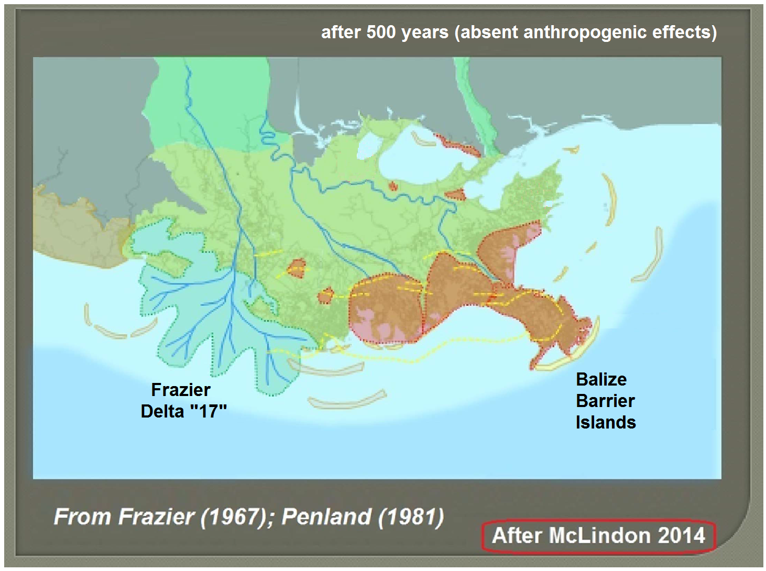
Who owns it?
Who
owns it?

Slide 43
Who owns it?
OK, we know the Louisiana answer for who owns the bottom; the land that has gone under.
And we know that answer - - in this state - - sometimes depends on why it sank; La. C.C. Art. 450; A.N. Yiannopoulos, Property, 2 Louisiana Civil Law Treatise § 65.
But what about the mineral rights and the oil/gas leases . . . who owns THEM once the land goes under even at low tide?

Slide 44


Why care who owns what?

Slide 45
La. R.S. 9:1151; the “freeze” statute (1952 and 2001)
Who owns it?
In all cases where a change occurs in the ownership of land or water bottoms as a result of the action of a navigable stream, bay, lake, sea, or arm of the sea, in the change of its course, bed, or bottom, or as a result of accretion, dereliction, erosion, subsidence, or other condition . . . the new owner . . . including the state of Louisiana, shall [be] encumbered with any oil, gas, or mineral lease [and] royalty rights; the right of the . . . mineral and royalty owners thereunder shall be in no manner abrogated or affected by such change in ownership.
Bold changed in 2001

Slide 46
Who wins in court, and why?
Coastal change is unlikely to require new law.
Virtually all of the recent major cases concerning water and/or coastal issues have been resolved by applying existing law.
Law does not “control nature” but it most assuredly controls who gains and who loses with change.
Coastal planning ought to stay within the realistic limits of what can be accomplished within our existing laws . . . and our budgets!
But if not . . . .

Slide 47
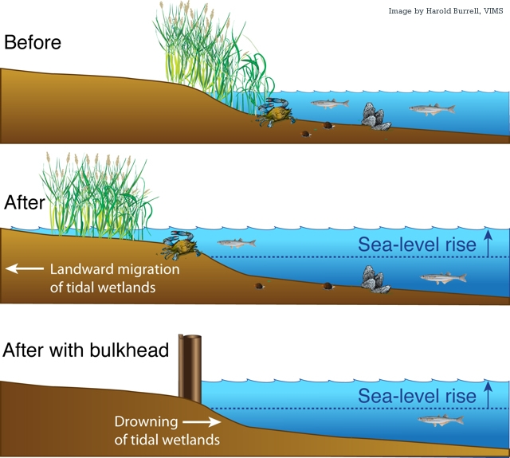
Where to from here?

Slide 48
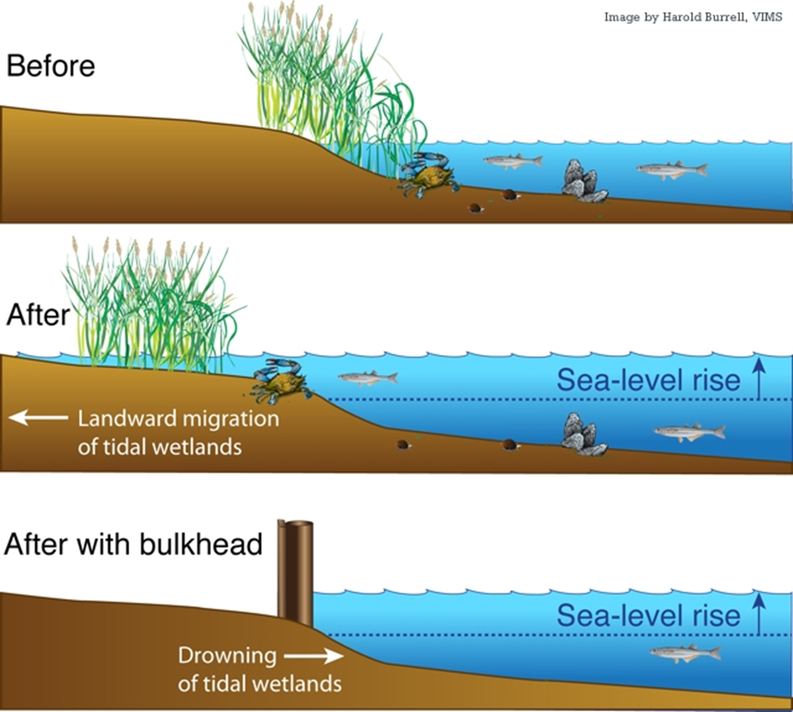
Where to from here?
By the way . . . what’s wrong with this slide?

Slide 49
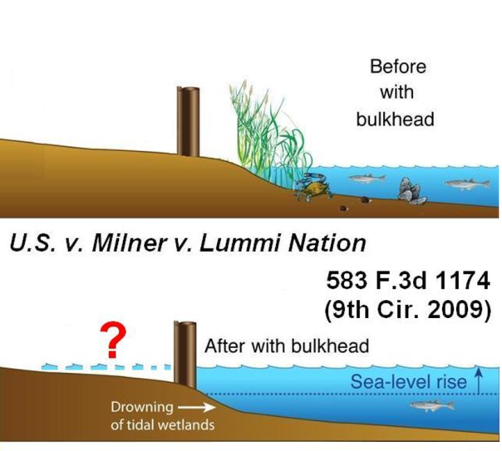
Where to from here?
Where to from here?

Slide 50
Where to from here?
Waterfront homeowners are liable for both common law trespass and violations of the Rivers and Harbors Appropriation Act of 1899 (RHA), but not of the Clean Water Act (CWA), because the ambulatory tideland property boundary now intersects shore defense structures.
Limit of RHA 1899 jurisdiction can be (NOT “must be”?) the landward projection of the sea absent the rocks/sea wall.

Slide 51
Where to from here?
Kelly’s 3 cents
Sec 10 permits for every “inland Milner” bulkhead would bury Corps’ desks.
IMHO, we got TOO MUCH Sec 404 already
“Freeze” statute constitutional? Doubtful (IMHO); only case not a “donation” claim

Slide 52


Slide 53
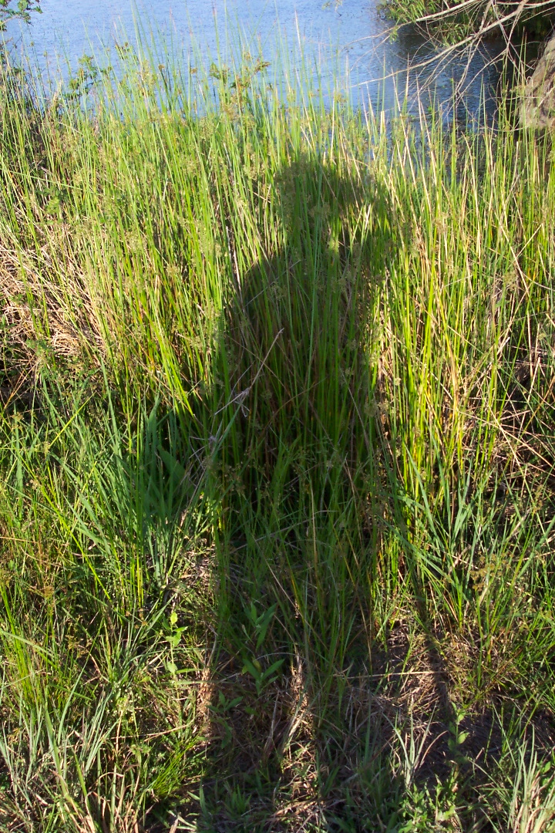

Thanks
Thanks for the opportunity to present Legal Aspects of Coastal Change!

Slide 55
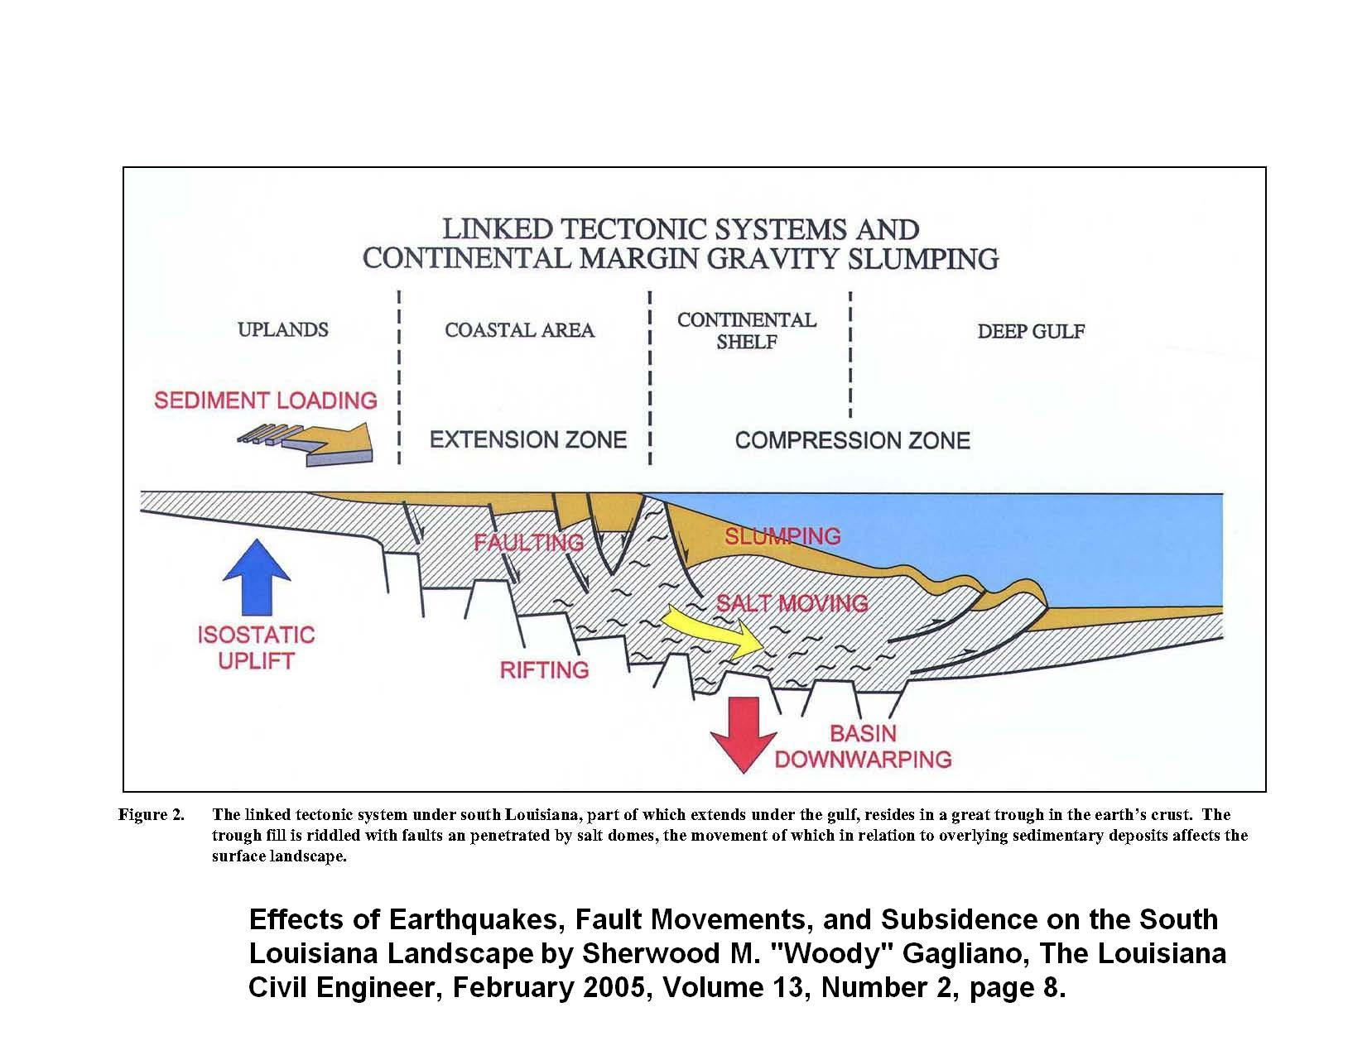

Slide 56
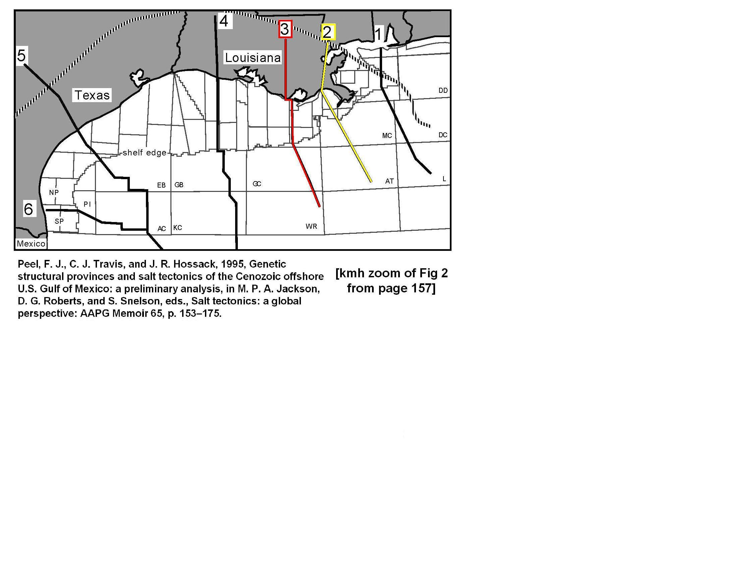

Slide 57
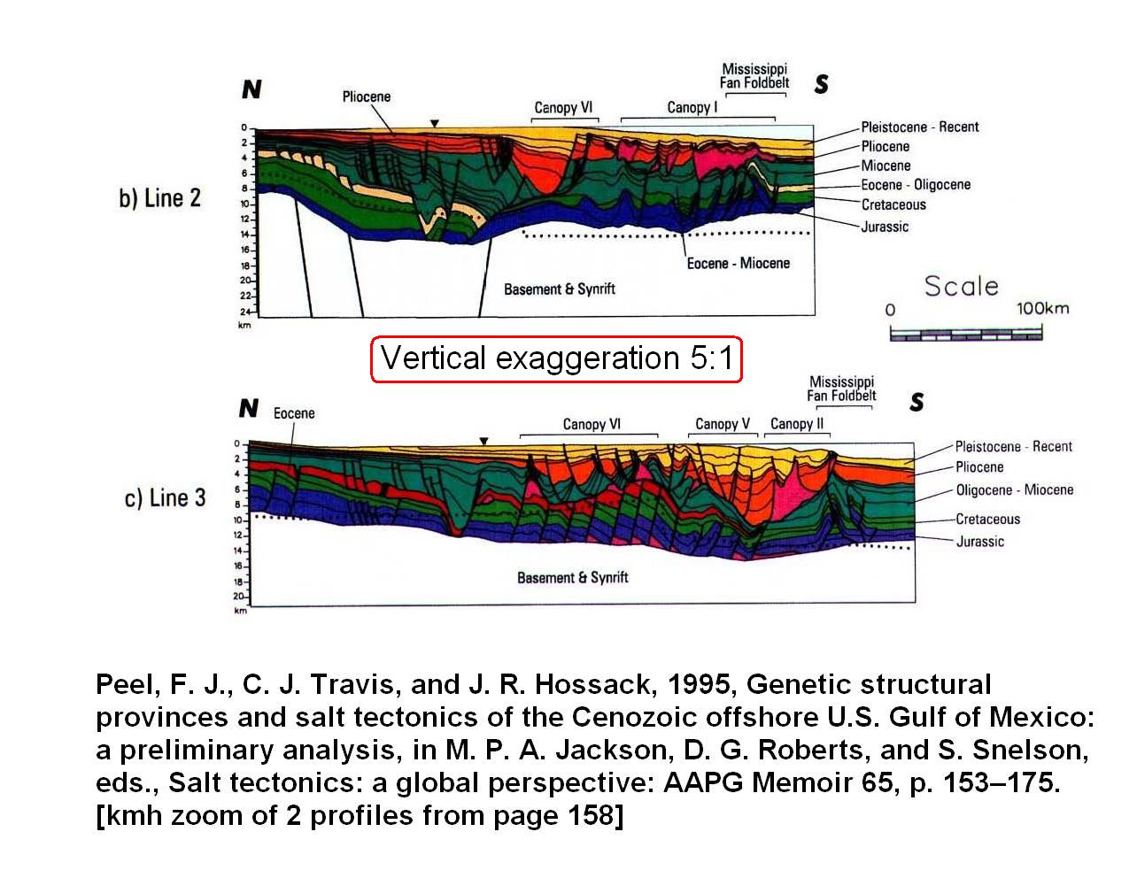

Slide 58
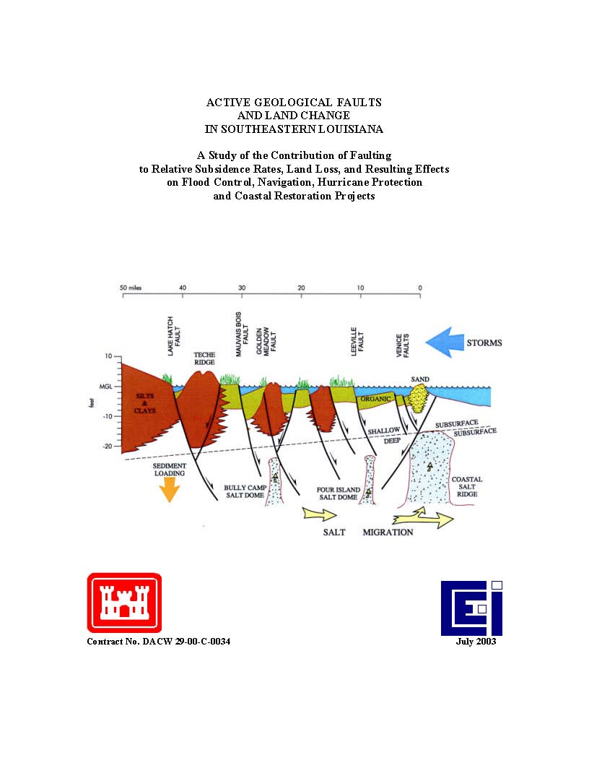

Slide 59
Where’s the beach? Severance v. Patterson
(2010) and (2012)
Does Texas recognize a “rolling” public beachfront
access easement, i.e., an easement in favor of the
public that allows access to and use of the beaches on
the Gulf of Mexico, the boundary of which easement
migrates solely according to naturally caused changes
in the location of the vegetation line, without proof of
prescription, dedication or customary rights in the
property so occupied? [1st of 3 “certified questions”]
Severance v. Patterson, 566 F.3d 490, 503–04 (5th Cir. 2009), certified questions accepted, 52 Tex. Sup. Ct.
J. 741 (May 15, 2009), slip opinion No. 09‑0387 (November 05, 2010) answered “No.” But, motion for re-
hearing granted March 11, 2011; oral argument was April 19, 2011.

Slide 60
Where’s the beach?
Severance v. Patterson: July 29, 2011 to March 30, 2012
After orals and briefs, but before Texas Spm Ct could rule on rehearing, Severance sold her last rental house to Galveston under a FEMA buyout program. Texas then moved to dismiss as moot plus vacate the original judgment of Nov 5, 2010; Severance objected.
Texas Spm Ct did neither. “Abated” making any ruling on July 29, 2011; sent the case back to 5th Cir. Whether the FEMA sale moots the federal case is a federal question. “Reverse cert” back to 5th; “Tell us what your law is.”
5th said “not moot” (Sep 28, 2011) so Texas again struck down the Open Beach Act (Mar 30, 2012) (but on different grounds).

Slide 61
Where’s the beach?
The Severance v. Patterson saga continues:
H. B. 3459 amends Section 61.001, Natural Resources Code,
effective Sept 1, 2013 -
Land Commissioner may temporarily suspend "line of
vegetation" up to 3 years when a "meteorological event"
results in "avulsion, erosion, accretion, or other impacts to
the shoreline that alter the location of the line of vegetation.“
Texas v. Brannan (City of Surfside wants several homes)
Jan 25, 2013 Texas Supreme reverses 1st Cir, sends case
back to Court of Appeals for “do over” in light of Severance.
May 1, 2014 1st Cir remands for trial; stay tuned . . . .

Slide 62
Who wins in court, and why?
Diversions affecting oyster beds (Avenal)
[T]he vast majority of the oyster fishermen are not entitled to compen-
sation under [a state takings or damage claim] because their leases
contain clauses holding the State harmless from any loss or damage
resulting from this [Caernarvon] coastal diversion project. Further, we
hold that the claims of the oyster fishermen whose leases do not
contain hold harmless clauses [were filed too late.]
(slip opinion page 2)
Further, the oyster statutes do not guarantee the oyster lessees with
a vested right to an optimal salinity regime in the State’s own waters,
nor that the state maintain a certain salinity regime favorable for
oyster cultivation.
(slip opinion page 30)

Slide 63
Who wins in court, and why?
Land loss from E & P canals Columbia Gulf
For plaintiffs to recover in this matter, they
must demonstrate as a matter of law that
defendants had a duty to these hundreds of
thousands of plaintiffs to protect them from
the results of coastal erosion allegedly
caused by operators that were physically
and proximately remote from plaintiffs or
their property (page 692).

Slide 64
Who wins in court, and why?
AGW/Climate Change made storms
and coastal damage worse
Native Village of Kivalina v. Exxon Mobil Corp. (cert. denied USSC 2013)
“AEP extinguished Kivalina’s federal common law public nuisance
damage action, along with the federal common law public nuisance abatement actions.” Kivalina, 696 F.3d at 857 (2012).
Comer v. Murphy Oil USA (5th Cir 2013)
Res judicata [a thing already judged] bars trespass, nuisance, and negligence claims against numerous oil, coal, electric, and chemical companies for damage from Hurricane Katrina. D’s actions are among the largest sources of GHG, cause global warming, high sea surface temperature, sea level rise; fueled Hurricane Katrina, which damaged their property. AGW caused higher insurance premiums, lowered the resale value of their homes - - D’s emissions are an unreasonable invasion of the P’s property rights.

Slide 65
Who wins in court, and why?
Increased levee costs from E & P canals and production itself (SELFPA- East)
P not a third party beneficiary to federal and state permits issued to D energy companies, so it has no claim.
Rivers and Harbors Act (1899), Clean Water Act (1977) and Coastal Zone Management Act (1972) do not make P an intended beneficiary of any duties imposed upon Ds.
“Natural servitude of drain" does not apply to hurricane storm surge; P has no claim to raise against Ds.

Slide 66
Corvallis Sand (1977)
Who owns it?
If the lands at issue did pass under the equal‑
footing doctrine, state title is not subject to defeasance [loss; revocation] and state law governs subsequent dispositions. A similar result obtains in the case of riparian [river bank] lands which did not pass under that doctrine; state law governs issues relating to such property, like other real property, unless some other principle of federal law requires a different result.
Oregon ex rel. State Land Board v. Corvallis Sand & Gravel Co., 429 U. S. 363 [riverbed]
and 429 U. S. 374 [new channel] (1977)

